Slide 1
Mimo and the future
By: Mouawia Alsaeed ;)

Slide 2
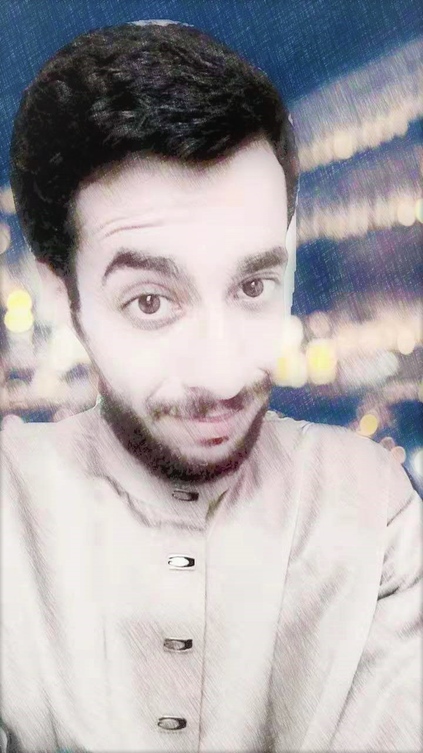
Basic Info
Race : Human
Name : Mouawia Alsaeed
Age : 28
Birthday : 23/12/1991
Nationality : Syrian
Gender : Male

Slide 3
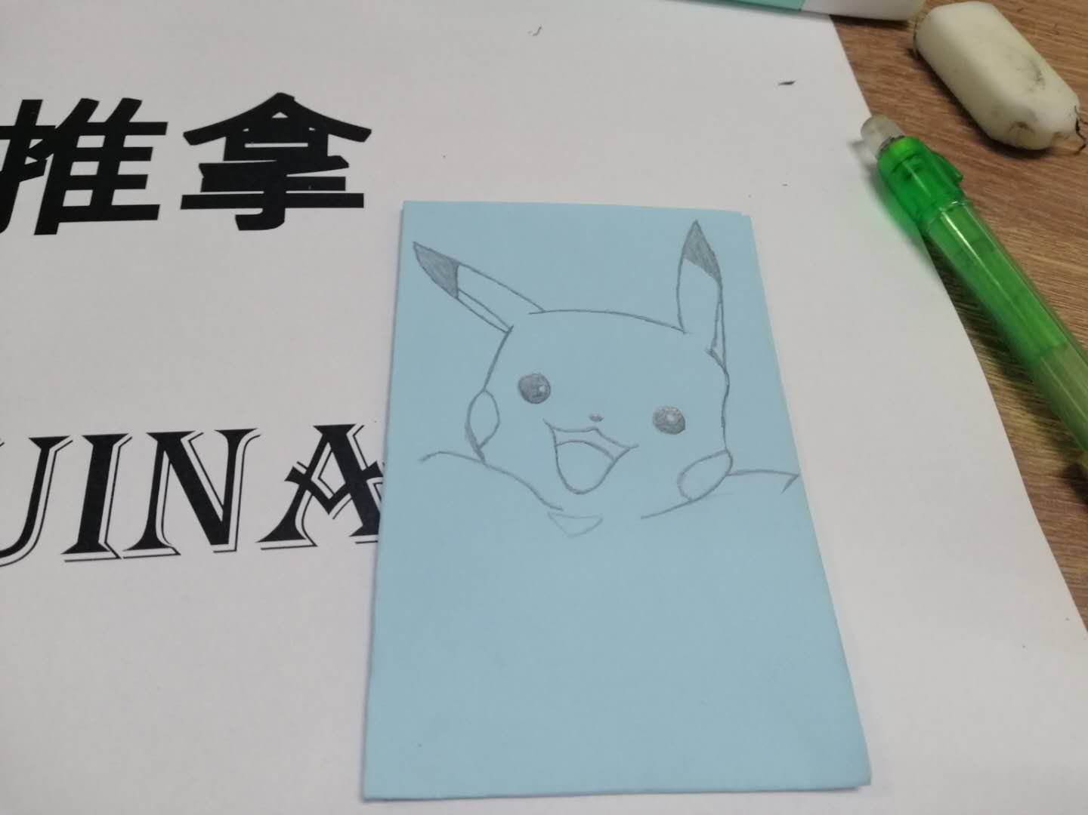

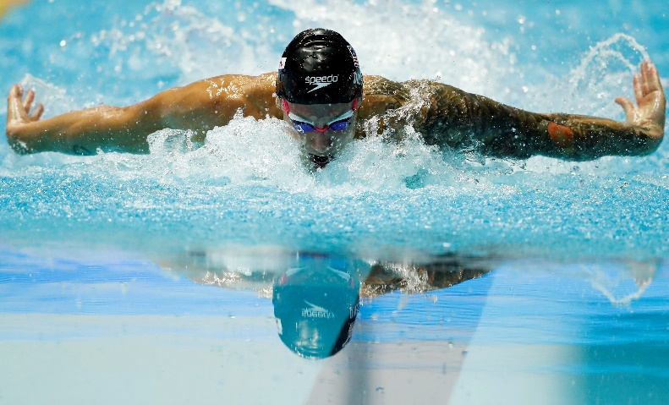
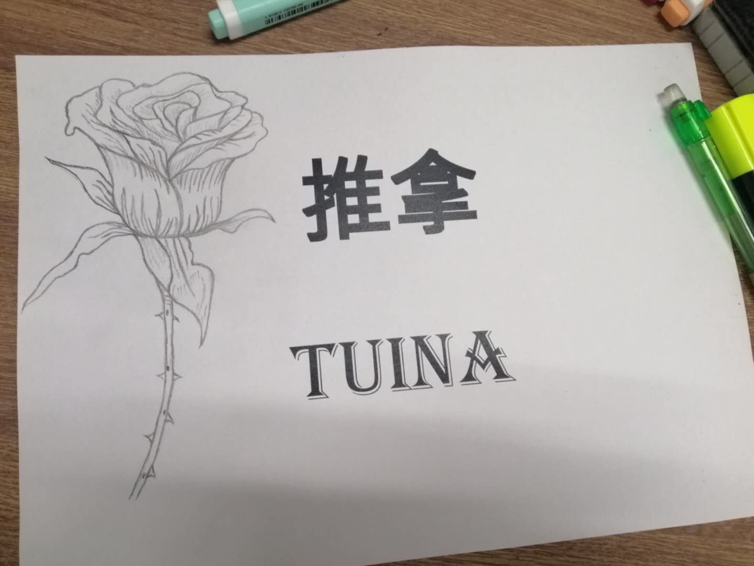
Hobbies
Keeping up with the science.
Drawing
swimming

Slide 4

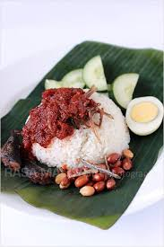
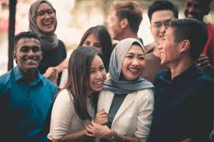
Malaysian Side:
Been here 7 Years
Had 1 year of it in XMUM
Love it because of:
-Food
-People
-Internet
-Mamak

